Slide 1
Supply Chain Management II
Computer Systems Management
Module Code CT012-3-3
Level 3
VD1

Slide 2
Learning Outcomes
Competitive and Supply Chain Strategies
Transportation
Global Supply Chain
Risk Management in Global Supply Chain

Slide 3
Content
Supply Chain Strategies
Strategic Fit
Supply Chain Integration
Transportation
Global Supply Chain
Obstacles in Global Supply Chain

Slide 4
Key Terms
Supply Chain Strategies
Strategic Fit
Supply Chain
Risk Management
Transportation

Slide 5
Competitive and Supply Chain Strategies
Competitive strategy - the set of customer needs a firm seeks to satisfy through its products and services
Product Development Strategy - specifies the portfolio of new products a company will try to develop
Marketing & Sales Strategy - how the market will be segmented, product positioned, priced and promoted
Supply Chain Strategy - determines the nature of material procurement, material transportation, manufacture of product or creation of service, distribution of product
All functional strategies must support one another and the competitive strategy

Slide 6
Strategic Fit
Strategic Fit – competitive and SC strategies have aligned goals
A company may fail because of a lack of strategic fit or because its processes do not provide the capabilities to execute the desired strategy
The first step in achieving strategic fit between competitive and SC strategies is to understand customers and SC uncertainty
Competitive strategy and all functional strategies must fit together to form a coordinated overall strategy

Slide 7
Supply Chain Integration
1. Information sharing among SC members
  Reduce bullwhip effect
  Early problem detection
  Quickresponse eg ToysRUs unable to deliver during holiday season. Lost 40% online customers
  Builds trust and confidence
2. Coordinated workflow, production and operations, procurement
  Production efficiencies
  Fast response i.e. no delays
  Improved service i.e. less defects
  Quicker to market

Slide 8
Collaborative Planning,
Forecasting and Replenishment
Process for two or more companies in a SC to synchronize their demand forecasts into a single plan to meet customer demand
Parties electronically exchange
  past sales trends
  point-of-sale data
  on-hand inventory
  scheduled promotions
  forecasts

Slide 9
Transportation
Role in the Supply Chain
  Moves product between stages in the SC
  Affects responsiveness and efficiency
  Faster transportation allows greater responsiveness but lower efficiency
Transportation Mode
  Air, truck, rail, sea, pipeline
  Information goods via the Internet
  Different speed, shipment size, cost, and flexibility

Slide 10
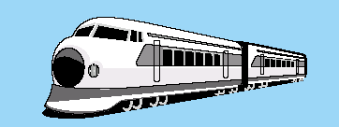
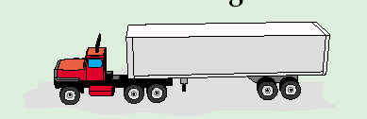
Transportation
Rail
low-value, high-density, bulk products, raw materials, intermodal containers
not economical for small loads. Slower, less flexible than trucking
Trucking
main mode of freight transport in U.S.
small loads, point-to-point service, flexible
More reliable, less damage than rails; more expensive than rails for long distance

Slide 11

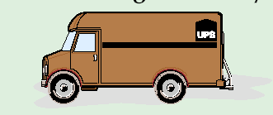
Transportation
Air
most expensive and fastest, mode of freight transport
lightweight, small packages
high-value, perishable, critical goods, less theft
Package Delivery
small packages
fast and reliable
increase with e-Business
primary shipping mode for Internet companies

Slide 12
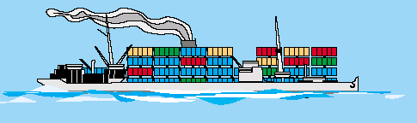
Transportation
Water
low-cost shipping mode
primary means of international shipping
slowest shipping mode
Intermodal
combines several modes of shipping-truck, water and rail
key component is containers
Pipeline
transport oil and products in liquid form
high capital cost, economical use
long life and low operating cost

Slide 13
Sourcing
1. Role in the SC
Set of business processes to purchase goods and services. Tasks be performed internally or a third party
2. In-house or Outsource
Perform task in-house or outsource to third party
Keep function in-house if outsourcing risk significant
3. Supplier Selection
Number of suppliers, evaluation criteria and selection
4. Procurement
Obtain goods and service within a SC

Slide 14
Global Supply Chain
Opportunities to increase revenue and decrease costs through international trade
Accompanied by significant risk
Ability to incorporate risk mitigation into SC design
Uncertainty of demand and price drives the value of building flexible production capacity

Slide 15
Impact of Globalization on Supply Chain Networks
Risk Factors | Percentage of Supply Chains Affected
Natural disasters | 35
Shortage of skilled resources | 24
Geopolitical uncertainty | 20
Terrorist infiltration of cargo | 13
Volatility of fuel prices | 37
Currency fluctuation | 29
Port operations/custom delays | 23
Customer/consumer preference shifts | 23
Performance of supply chain partners | 38
Logistics capacity/complexity | 33
Forecasting/planning accuracy | 30
Supplier planning/communication issues | 27
Inflexible supply chain technology | 21

Slide 16
Risk Management in Global Supply Chain
Risks include supply disruption, supply delays, demand fluctuations, price fluctuations and exchange-rate fluctuations
Critical for global SC to be aware of the risk factors and build suitable mitigation strategies
Global SC should use a combination of rigorously evaluated mitigation strategies and financial strategies to hedge uncovered risks

Slide 17
Risk Management in Global Supply Chain
Category | Risk Drivers
Disruptions | Natural disaster, war, terrorism Labor disputes Supplier bankruptcy
Delays | High capacity utilization at supply source Inflexibility of supply source Poor quality or yield at supply source
Systems risk | Information infrastructure breakdown System integration or extent of systems being networked
Forecast risk | Inaccurate forecasts due to long lead times, seasonality, product variety, short life cycles, small customer base Information distortion

Slide 18
Risk Management in Global Supply Chain
Risk Mitigation Strategy | Tailored Strategies
Increase capacity | Focus on low-cost, decentralized capacity for predictable demand. Build centralized capacity for unpredictable demand. Increase decentralization as cost of capacity drops.
Get redundant suppliers | More redundant supply for high-volume products, less redundancy for low-volume products. Centralize redundancy for low-volume products in a few flexible suppliers.
Increase responsiveness | Favor cost over responsiveness for commodity products. Favor responsiveness over cost for short–life cycle products.

Slide 19
Obstacles in Global Supply Chain
Increased documentation for invoices, cargo insurance, letters of credit, inspections
Changing regulations from country to country that govern the import and export of goods
Trade groups, tariffs, duties and landing costs
Limited shipping modes
Numerous players including forwarding agents, financial institutions, insurance providers, multiple transportation carriers and government agencies
Different business practices and language barries

Slide 20
Summary
Question and Answer Session
Competitive strategy - customer needs that a firm seeks to satisfy through its products and services
Product Development Strategy - specifies portfolio of new products
Supply Chain Strategy - determines the nature of material procurement, material transportation, manufacture of product or creation of service, distribution of product
  Transportation - moves products between stages in the SC

Slide 21
Review Questions
Question and Answer Session
Describe some of the transportation modes
What is Global SC
Explain the obstacles in Global SC

Slide 22

Question and Answer Session
Question and Answer Session
Q & A

Slide 23
What We will Cover Next
Question and Answer Session
Systems Security

